Slide 1
Ensemble Learning of Convolutional Neural Network, Support Vector Machine, and Best Linear Unbiased Predictor for Brain Age Prediction: ARAMIS Contribution to the Predictive Analytics Competition 2019 Challenge
Reporter: Ping-Hsueh Ho

Slide 2
Outline
Background & Motivation
Hypothesis
Materials
Proposed Methods
Designed Experiment
Results and Comparisons
Conclusion

Slide 3
Background & Motivation
Chronological age is an important risk factor for many conditions
However, it is an imperfect predictor of disease risk or of healthy individuals’ functional capability
Latest research focus on …
→ telomere length, methylation site, brain structure, and function
Especially MRI
Notes:
實際年齡是許多疾病的重要風險因素，例如神經系統疾病(阿爾茨海默氏症和帕金森氏症）、慢性（包括心血管）疾病、癌症或中風等等
然而，它不能完美預測疾病風險或健康個體的功能能力
越來越多的研究領域一直專注於識別年齡的生物學相關性（例如，從端粒長度、甲基化位點、大腦結構和功能）來推導出生物學年齡的測量值
特別是，根據 MRI 圖像估計腦年齡是一個快速擴展的研究領域

Slide 4
Background & Motivation
Predicted age difference (PAD)
Brain age (and PAD) trained on healthy participants may be applied to case-control samples
However…chronological age cannot explain everything
Notes:
PAD→定義為預測年齡和實足年齡之間的差異。PAD與死亡率和功能指標相關
此外，在健康參與者身上訓練的腦齡（和 PAD）可應用於病例對照樣本，在這些樣本中它們已被證明是疾病狀態的非特異性預測因子
但…大腦年齡與疾病、死亡率和功能的相關性超出了實足年齡所能解釋的範圍

Slide 5
Problem Statement

Slide 6
Hypothesis
Try different predictive algorithms [CNNs, SVM, and best linear unbiased predictor (BLUP)]
Try to analyze the effect as below on the brain age prediction ACC
of MRI processing
of number of models combined
of site, sex, and age
Notes:
(i) MRI 處理的效果； (ii) 合併的模型數量； (iii) 地點、性別和年齡對大腦年齡預測準確性的影響

Slide 7
Materials
Average age: 35.8 year
53% female
Unbalanced

Slide 8
Materials – Image Features
Gray Matter and White Matter Maps – PAC team
Non-linear registered to the MNI152 space
Segmentation: SPM12 + DARTEL
Smooth processing: 4-mm kernel
Notes:
說到registration,就必須要首先介紹一下模板.由於人腦存在個體差異, 掃描時候的圖像在空間中的坐標也不同, 研究時必須要首先消除個體差異,統一坐標, 也就是需要將被試人員的大腦全部”訂正/配準”到標準模板上, 這樣後續才能進行統計分析.目前國際上最廣泛使用的標準模板是MNI152. MNI是加拿大的蒙特利爾神經科學研究中心 “Montreal Neurosciences Institute”的縮寫. MNI152采用了152個健康人的152 3D T1數據加權平均得到. 根據平均算法不同, 分為線性linear和非線性nonlinear兩種

Slide 9
Materials – Image Features
Surface-Based Processing of Gray Matter – For raw T1w image
Extract vertex-wise measurements of cortical thickness and surface area: FreeSurfer 6.0
Extract a vertex-wise characterization of seven subcortical nuclei thickness and surface: ENIGMA-shape protocol
Our processing resulted in ~650,000 gray matter measurements per individual
Processing failed: 3.4% for training sample / 3.2% for PAC test set
Notes:
T1w image:不同類型醫療影像能夠提供特定之診斷訊息，如：MRI中T1權重影像(T1-weighted image, T1w image)提供高空間解析度之組織對比結構影像，可觀察到組織器官之間的空間資訊
使用FreeSurfer 6.0 處理原始 T1w 圖像以提取皮質厚度和表面積的頂點測量值
使用 ENIGMA-shape 協議進一步提取七個皮層下核厚度和表面的頂點特徵
與其他基於表面的處理相比，這些處理最大化了與年齡的關聯
training sample中有3.4%處理失敗，而testing dataset中也有3.2%處理失敗，原因是lower image quality

Slide 10
Proposed Methods – BLUP
Minimizing the mean square error within the class of linear unbiased predictors
Computationally efficient – use estimated variance–covariance matrix between the features
Use OSCA[35] to compute BLUP score
Notes:
BLUP score有個理想特性是，會minimize類別的linear unbiased predictor的MSE(mean square error)，使得在遺傳學方面的預測有不錯的成績，且BLUP的計算是很有效率的(因為不需要hyperparameter estimation)，BLUP 使用特徵（此處為頂點）之間的estimated variance–covariance matrix來導出特徵與每個頂點之間的joint marginal associations

Slide 11
Proposed Methods – BLUP
BLUP-mean: scores using the mean and SD calculated from each site of the discovery sample
BLUP-quantiles: applied quantile-based scaling to address non-normal distribution

Slide 12
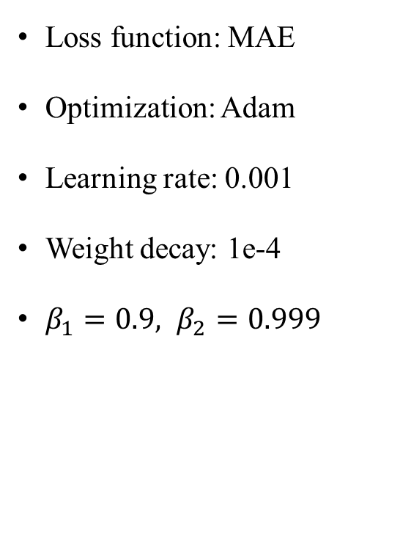
Proposed Methods – 6-Layer CNN
Loss function: MAE
Optimization: Adam
Learning rate: 0.001
Weight decay: 1e-4
$β_{1}=0.9, β_{2}=0.999$

Slide 13
Proposed Methods – Special 6-Layer CNN
This model is the combination of two 6-layer CNNs with the architecture described in the previous section
First CNN: for whole dataset
Second CNN: only older than 40
Notes:
Special CNN model是由兩個6-Layers CNN的結構組成(每一個6-Layer CNN架構都是如前一節所示)，第一個是train全部的dataset，而第二個是只train 40歲以上的data，所以年輕的data prediction是只有第一個CNN參與predict，若是較老的data prediction，則由整個model給出最後的年齡

Slide 14
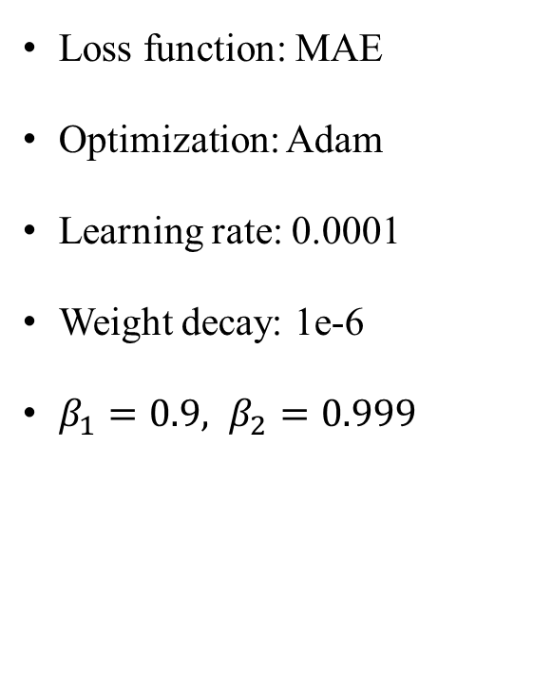
Proposed Methods – ResNet
Loss function: MAE
Optimization: Adam
Learning rate: 0.0001
Weight decay: 1e-6
$β_{1}=0.9, β_{2}=0.999$
Notes:
整體結構：該模型是一個 3D CNN，由五個residual block組成，每個residual block後跟一個kernel size為 3 × 3 × 3 且step size為 2 × 2 × 2 的max-pooling layer，然後是一個flatten layer和一個fully connected block。
細部結構：每個residual block都是重複兩次的層的組合。每layer由kernel size為 3×3×3、step size 為 1×1×1 的 3D 卷積層、batch normalization layer和exponential linear unit (ELU) activation function組成，在最後一個activation function之前添加一個跳過連接

Slide 15
Proposed Methods – Inception V1
Loss function: MAE
Optimization: Adam
Learning rate: 0.0001
Batch size: 8 images
Notes:
最後的 softmax layer被移除，留下一個fully connected layer作為最後一層，從而確保regression task而不是classified task(很明確，因為是要預測一個明確的數值)
為了防止梯度消失所以用auxiliary layer處理梯度消失的問題

Slide 16
Proposed Methods – Overall
Train/Test: 2107/533(8:2)
5-Fold CV for SVM
Notes:
作者觀察到，根據年齡和預測誤差之間的 Spearman correlation定義，使用中位數和mean absolute deviation對每個年齡score進行scaling大大減少了bias。 因此，作者轉換每個score並使用如上所述的linear regression將它們組合起來

Slide 17
Designed Experiment – Additional
Individual Performance of Each Algorithm
5-Folds CV on 2640 PAC individuals
Use Paired t-test to compare the performance of the algorithms
Different Types of Model Combination: Linear Regression vs. Random Forest
Mean score for each individual
Median score
Linear combination with weights estimated from linear regression
Scores combination from random forest regression – composed of 100 trees of maximum depth 15
Notes:
我們對 2,640 個 PAC 個體使用了 5-Folds CV設計，以評估每個演算法預測精度的穩定性
針對combination，作者提出四種ensemble learning的組合

Slide 18
Designed Experiment – Additional
Influence of the Type of Brain Features on Prediction Accuracy
Sex, Age, and Site Bias

Slide 19
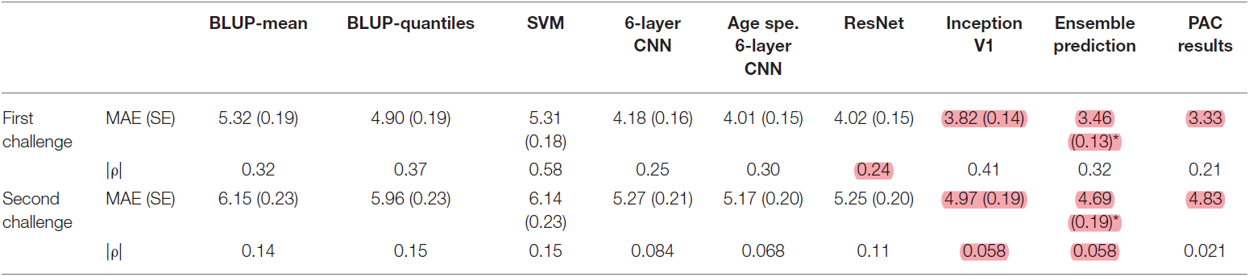
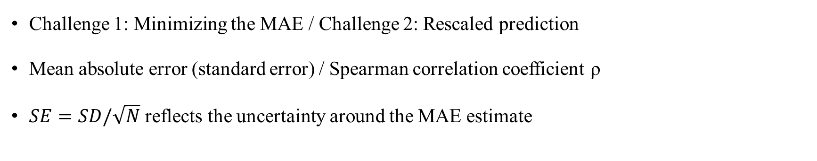
Results & Comparisons – Validation Set
Challenge 1: Minimizing the MAE / Challenge 2: Rescaled prediction
Mean absolute error (standard error) / Spearman correlation coefficient ρ
$SE=SD/\sqrt{N}$ reflects the uncertainty around the MAE estimate
Notes:
*符號代表與單獨的 Inception 相比，通過Ensemble Learning顯著減少了 MAE (p < 0.05)

Slide 20
Results & Comparisons – Validation Set
Challenge 1: Paired t-test between deep learning algorithm and BLUP/SVM(p<3.1e-4)
Paired t-test between deep learning algorithm has not significant difference(p>0.027)
Ensemble Learning has significant difference(p=1.3e-4)
Challenge 2: Paired t-test between ensemble learning and Inception(p=0.010)
Notes:
以minimize MAE這個objective來說，深度學習的方式比BLUP和SVM(paired t-test的p-value<3.1e-4)代表有顯著性差異(正常只要<0.05就是有顯著性差異)
Inception MAE=3.82且six-layer CNN MAE=4.18，相較之下BLUP-quantiles的MAE=4.90
深度學習演算法的表現沒有顯著性差異(p > 0.027)
相較之下Ensemble Learning的MAE=3.46，有顯著差異(p=1.3e-4)
以挑戰2來說，作者用median和man absolute deviation per site去rescaled prediction，結果顯示MAE會比原來的增加一年，但會減少bias，同樣的ensemble learning相比於Inception有顯著提升(p=0.010)

Slide 21
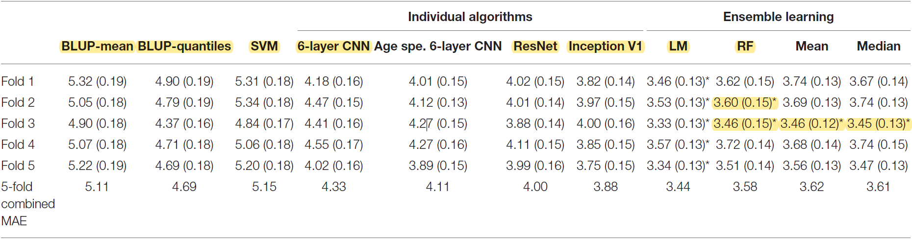
Results & Comparisons – Additional Exp.
Paired t-test between BLUP/SVM and ResNet (p < 5.5E−3)
Paired t-test between BLUP/SVM and Inception V1 (p < 5.3E−5)
Notes:
*表示與單獨的 Inception 相比，通過集成學習顯著減少了 MAE（p < 0.01，假設有五個獨立測試）
試圖通過執行 5 折交叉驗證實驗來評估我們的結論是否依賴於上一節中使用的訓練/測試拆分
在每個fold中，我們發現 BLUP/SVM 和 ResNet 之間的 MAE 存在名義上的顯著差異(p < 5.5E−3)
BLUP/SVM 和 Inception V1 之間的差異在四個折疊中是顯著的(p < 5.3E−5)

Slide 22

Results & Comparisons – Additional Exp.
In each fold, linear regression(LM) is better than Inception V1(p<0.0022)
RF is better than Inception V1 only in Fold2 and Fold3(p=4.0E−3and 3.4E−4)
Significant Difference
Notes:
在每個 fold中，使用線性回歸的綜合年齡得分優於 Inception V1 的預測 (p < 0.0022)。對於折疊 2 和 3，通過隨機樹進行的集成學習明顯優於單獨的 Inception V1(p=4.0E−3and 3.4E−4)
需要注意的是，使用隨機森林獲得的 MAE 非常接近通過對每個人取平均或中位數分數獲得的 MAE。我們無法得出線性模型組合與隨機森林之間存在顯著差異的結論

Slide 23
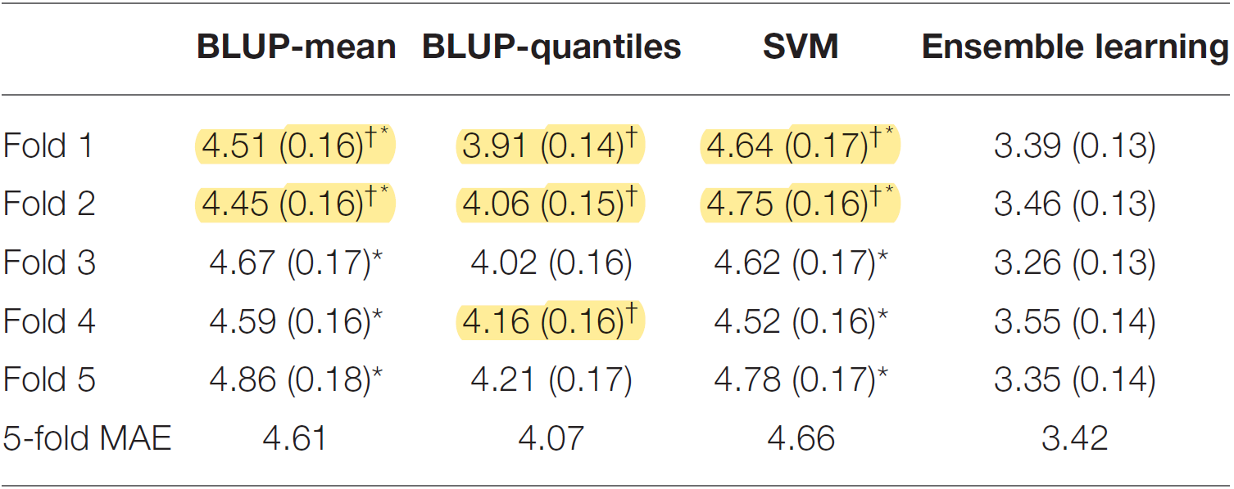
Results & Comparisons – Additional Exp.
†Algorithm trained on gray matter maps performs significantly better than the same algorithm trained on surface-based vertices (p < 0.05/15)
*Algorithm trained on gray matter maps performs significantly worse than Inception V1 (p < 0.05/15)
Notes:
與深度學習算法相比，BLUP/SVM 的性能較低，這促使作者想要測試它是否可以歸因於input data或algorithm本身
因此作者對於BLUP和SVM進行再訓練(trained on gray matter maps)
†符號代表：用gray matter map訓練的演算法明顯優於在surface-based vertices訓練的演算法(p < 0.05/15)
*在灰質圖上訓練的算法的性能明顯低於 Inception V1 (p < 0.05/15)
儘管 MAE 有所減少，但在灰質圖上訓練的 BLUP-mean 和 SVM 的表現仍然比 Inception V1 差（p < 0.0033），雖然 Inception V1 和 BLUP-分位數之間的差異在所有折疊中變得不顯著（表 3).
包括基於gray matter map的 BLUP 和 SVM 預測並沒有提高ensemble learning的性能超過上面報告的內容

Slide 24
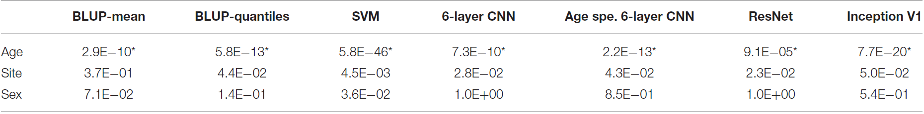
Results & Comparisons – Additional Exp.
Predicted age tended to underestimate the age of older participants and overestimate age of younger individuals.
We did not observe a significant association of prediction error with sex or site
Notes:
作者年齡越大，預測的誤差也越大->因此，預測的年齡往往會低估年長參與者的年齡而高估年輕人的年齡
我們沒有觀察到預測誤差與性別或地點的顯著關聯

Slide 25
Analysis and Discussion

Slide 26
Conclusion
Proposed an ensemble learning algorithm of 7 different age predictions from T1w MRI images
Ranked third in PAC2019
Ranking of prediction accuracy may be highly dependent on the metric chosen as well as on the test data
Evaluated the effect on performance of algorithm choice, ensemble learning methods, feature input/data processing, number and type of scores in ensemble learning, and covariates such as age, sex, and site
Notes:
重要的是要記住，預測準確性的排名可能在很大程度上取決於所選的指標以及測試數據
作者評估了 (i) 算法選擇，(ii) ensemble learning方法，(iii) 特徵輸入/數據處理，(iv) ensemble learning中score的數量和類型，以及 (v) 協變量等對性能的影響 如年齡、性別和地點

Slide 27
Q&A
Thank you

